Slide 1

LLMs & RAG for Identifying Illicit Drug Use on Social Media
James Chapman
CIS 830 Advanced Topics in AI– Term Project
Kansas State University
jachapman@ksu.edu
Project Repository & Code
https://github.com/JamesChapmanNV/830_Project

Slide 2
Overview
Background
Data
Retrieval Augmented Generation (RAG)
Experiments
Results
Fine-tuning
Discussion
Future work
Notes:
I think everybody knows that lithium-ion batteries is a growing technology with a big future. And that batteries have a shelf life.

Slide 3
Background
NER, TE, Entity Linking, Term Disambiguation
Pharmacovigilance
Classification Tasks
About illicit/abusive drug use (binary)
Entity Linking - mentions of drugs of interest
Notes:
I think everybody knows that lithium-ion batteries is a growing technology with a big future. And that batteries have a shelf life.

Slide 4
Background
Named Entity Recognition
‘classic’ methods:

Slide 5
Background
Manual

Slide 6
Data
X (Twitter)
Reddit
Notes:
I think everybody knows that lithium-ion batteries is a growing technology with a big future. And that batteries have a shelf life.

Slide 7
Data
Substances of interest (Dr. McGinty’s list)
2,6-Xylidine
2-amino-5-chloropyridine
2-fluoro-2-oxo PCE
2-Oxo-3-hydroxy-LSD
3-hydroxy flubromazepam
3-hydroxy flubromazepam glucuronide
4-ANPP
4-HIAA
6-acetylmorphine
7-aminoclonazepam
7-hydroxymitragynine
7-OH-CBD glucuronide
8-aminoclonazolam
8R-OH-R-HHC
8S-OH-R-HHC
alpha-hydroxyalprazolam
alpha-hydroxybromazolam
Amphetamine
Benzoylecgonine
Bromazolam
Buprenorphine
Carfentanil
CBD
Codeine
Cyclobenzaprine
delta-8-THC-COOH
delta-9-THC-COOH
Diphenhydramine
EDDP
Fentanyl
Flubromazepam
Gabapentin
Hydrocodone
Hydromorphone
Ketamine
Lorazepam
LSD
MDA
MDMA
MDMB-4en-PINACA butanoic acid
Meperidine
Meprobamate
Methadone
Methamphetamine
Metonitazene
Mitragynine
Morphine
N,N-dimethylpentylone
Naltrexone
N-desethylmetonitazene
Norbuprenorphine
Norcarfentanil
Nordiazepam
Norfentanyl
Norketamine
Normeperidine
Noroxycodone
N-Pyrrolidinoetonitazene
O-desmethyltramadol
ortho-methylfentanyl
Oxazepam
Oxycodone
Oxymorphone
para-Fluorofentanyl
para-Fluoronorfentanyl
Pentylone
Phencyclidine
Pregabalin
Psilocin
Psilocybin
R-HHC-COOH
S-HHC-COOH
Speciociliatine
Temazepam
Xylazine
Zolpidem
Zopiclone

Slide 8
Data
Synonym lists from 5 sources.
PubChem's Python API - PubChemPy
DEA Slang Terms and Code Words: A Reference for Law Enforcement Personnel
DEA emoji drug codes
GitHub Repo for GPT 3 Paper
Carpenter KA, Altman RB. Using GPT-3 to Build a Lexicon of Drugs of Abuse Synonyms for Social Media Pharmacovigilance. Biomolecules. 2023; 13(2):387. https://doi.org/10.3390/biom13020387
GitHub Repo for RedMed Paper
Lavertu, A. & Altman, R. B. RedMed: Extending drug lexicons for social media applications. bioRxiv (2019). https://doi.org/10.1101/663625

Slide 9
Data
Reem Al-Ghannam, R., Ykhlef, M. & Al-Dossari, H. Robust Drug Use Detection on X: Ensemble Method with a Transformer Approach. Arab J Sci Eng 49, 12867–12885 (2024). https://doi.org/10.1007/s13369-024-08845-6
112,057 tweets from 2008 to 2022
*** Manually annotated ?
X/Twitter character limit
Randomly sampled 1000 tweets
Hand-Labeled 117
binary classification (about illicit/abusive drug use)
identified term/phrase that referenced a drug
Matched term/phrase to substances of interest

Slide 10
Data
Reddit history
Via Academic Torrents
All Reddit submissions/posts 2012- Dec 2024
Filter based on a list of subReddits and months
subReddits - currently have list of over 600 known drug-related subReddits
https://academictorrents.com/details/ba051999301b109eab37d16f027b3f49ade2de13
Unlabeled
Dates included

Slide 11
Experiments
About illicit/abuse of drug use
(binary)
Entity linking
(Multi-label matching)
Notes:
I think everybody knows that lithium-ion batteries is a growing technology with a big future. And that batteries have a shelf life.

Slide 12
Experiments
4 LLMs (2 Paid Services & 2 Local HuggingFace Models)
- o4-mini
- GPT-4o-mini
- Meta-Llama-3.1-8B-Instruct
- Qwen-4B
4 Prompts
- Short (T/F)
- Long (True/False and Explanation)
- Entity Linking (term/phrase → matched drug of interest)
- RAG Entity Linking

Slide 13
Experiments – ‘Short’ Prompt
‘ Short’ prompt
You moderate social‑media posts for drug abuse.
Label rules
T – text shows illicit or abusive drug use (using, seeking, buying, selling, trafficking, or slang for drugs).
F – all other cases (medical/policy discussion, news, discouraging use, metaphor).
Return only **T** or **F**, no additional text, reasoning, or explanation.
Post: "{{tweet_text}}"
Label:

Slide 14
Experiments – ‘Long’ Prompt
### Role
You are an expert content moderator specializing in identifying drug-related content on social media.
### Task
Classify the content as either ILLICIT/ABUSIVE-DRUG-RELATED (True) or NOT ILLICIT/ABUSIVE-DRUG-RELATED (False).
Provide a one sentence explanation for your classification.
### Output: JSON format
{ "label": "True" or "False", "explanation": "Your reasoning for the classification.“ }
### Definitions
True include content that:
- Mentions illegal, RX, or OTC drugs in the context of abuse or misuse (using, buying, promoting, etc.)
- Uses slang, euphemisms, or cultural references that signal recreational drug use or drugabuse.
- Encourages or glorifies drug misuse
False include content that:
- Mentions drugs in a medical, educational, or preventative context (discouraging)
Uses drug-related terms in a different context or unrelated topics
--- Example #1 ---
Content: I got her hooked on that lean everyday she say she want codeine
{"label": "True", "explanation": "The content mentions 'lean' and 'codeine,' and explains 'hooked' 'everyday' with an approving, supportive tone.."}
--- Example #2 ---
Content: Pharmacology lecture today covered how buprenorphine helps treat opioid addiction
{"label": "False", "explanation": "Educational context discussing medication assisted treatment, no promotion of misuse."}
(Do NOT include anything except True or False)
Content: {{tweet_text}}

Slide 15
Experiments – ‘Entity Linking’ Prompt
### Role
You moderate social‑media content for drug‑related references.
### Tasks
Given a post:
1. Detect every word or phrase (slang, euphemism, synonym, cultural references) that refers to an illicit drug or substance.
• Include illegal, RX, OTC, or recreational drugs (using, buying, promoting, encouraging or glorifying drug use).
2. Link each detected phrase to its matching **Index Term** (see list below).
• If the drug is *not* in the list, use "other".
3. Return **only** a valid JSON array, one object per match, using the schema
`{"index_term": "<Index Term or other>", "matched_phrase": "<exact text>"}`.
### Output: exact format
[
{"index_term": "Codeine", "matched_phrase": "lean"},
{"index_term": "Codeine", "matched_phrase": "codeine"},
...
]
### Index Terms
2,6-Xylidine (2,6-Dimethylaniline, 2‑amino‑1,3‑dimethylbenzene) – A toxic aniline derivative used as an intermediate in manufacturing local anesthetics and dyes.
2‑Amino‑5‑chloropyridine (5‑Chloro‑2‑aminopyridine) – A breakdown product of the sleep drug zopiclone that serves as a urinary marker in drug tests.
2‑Fluoro‑2‑oxo PCE (CanKet, 2F‑NENDCK, 2‑FXE) – A novel ketamine‑like dissociative anesthetic sold illicitly for its hallucinogenic effects.
2‑Oxo‑3‑hydroxy‑LSD (2‑oxo‑3‑hydroxy lysergic acid diethylamide, oxo‑HO‑LSD) – The principal urinary metabolite of LSD produced after psychedelic use.
3‑Hydroxy flubromazepam () – A primary metabolite of the designer benzodiazepine flubromazepam detectable in urine for an extended period.
3‑Hydroxy flubromazepam glucuronide () – The glucuronidated form of 3‑hydroxy flubromazepam that aids bodily elimination of the parent drug.
4‑ANPP (Despropionyl fentanyl, 4‑anilino‑N‑phenethylpiperidine) – A key precursor and metabolite of fentanyl often found as an impurity in illicit opioid production.
4‑HIAA (4‑Hydroxyindole‑3‑acetic acid) – The main inactive metabolite excreted after psilocybin ingestion (“magic mushrooms”).
6‑Acetylmorphine (6‑Monoacetylmorphine, 6‑MAM) – An active intermediate metabolite formed almost immediately after heroin use.
7‑Aminoclonazepam () – The chief urinary metabolite of the prescription benzodiazepine clonazepam.
7‑Hydroxymitragynine (7‑OH‑Mitragynine) – A potent kratom alkaloid and human metabolite that produces strong opioid‑like effects.
7‑OH‑CBD glucuronide () – A conjugated metabolite formed during cannabidiol (CBD) metabolism and excreted in urine.
8‑Aminoclonazolam () – A metabolite indicating use of the designer benzodiazepine clonazolam in toxicology screens.
8R‑OH‑R‑HHC (8α‑hydroxy‑9β‑HHC) – A hydroxylated metabolite of the synthetic cannabinoid HHC produced during metabolism.
8S‑OH‑R‑HHC (8β‑hydroxy‑9β‑HHC) – The epimeric hydroxylated metabolite of R‑HHC likewise formed in users of HHC products.
α‑Hydroxyalprazolam (α‑OH‑alprazolam) – The major active metabolite of alprazolam (Xanax) contributing to its sedative effects.
α‑Hydroxybromazolam (α‑OH‑bromazolam) – An oxidative metabolite used to confirm bromazolam ingestion.
Amphetamine (Speed, Bennies, Adderall) – A central nervous system stimulant prescribed for ADHD that is frequently abused for euphoria and wakefulness.
Benzoylecgonine (BZE, Ecgonine benzoate) – The primary metabolite of cocaine measured in urine drug testing.
Bromazolam (XLI‑268, Fake Xanax) – A designer benzodiazepine sold illicitly that mimics the sedative effects of alprazolam.
Buprenorphine (Suboxone, Subutex, Bupe) – A partial opioid agonist used to treat opioid dependence and moderate pain with a ceiling on respiratory depression.
Carfentanil (Wildnil, Elephant tranquilizer) – An ultra‑potent fentanyl analog used for large‑animal sedation and deadly in microgram doses to humans.
CBD (Cannabidiol, Epidiolex) – A non‑intoxicating cannabinoid with antiepileptic and anxiolytic properties approved for certain seizure disorders.
Codeine (Lean, Purple Drank, Schoolboy) – A mild opioid painkiller and cough suppressant that is widely abused in syrup form for euphoric “lean.”
Cyclobenzaprine (Flexeril, Amrix, Fexmid) – A muscle relaxant related to tricyclic antidepressants used for short‑term relief of muscle spasms.
delta‑8‑THC‑COOH (11‑nor‑9‑carboxy‑delta‑8‑THC) – The main inactive urinary metabolite indicating use of delta‑8‑THC products.
delta‑9‑THC‑COOH (11‑nor‑9‑carboxy‑THC, THC‑COOH) – The principal inactive metabolite of cannabis’ delta‑9‑THC detected in urine screens.
Diphenhydramine (Benadryl, Nytol) – A first‑generation antihistamine with sedative and anticholinergic effects that is sometimes misused at high doses.
EDDP () – The inactive metabolite of methadone used to verify methadone compliance in treatment programs.
Fentanyl (China White, Apache, Duragesic) – A synthetic opioid 50–100 times stronger than morphine that drives many overdose deaths.
Flubromazepam () – A long‑acting “research chemical” benzodiazepine producing prolonged sedation and anxiolysis.
Gabapentin (Neurontin, Gralise, Gabbies) – An anticonvulsant prescribed for neuropathic pain and seizures that carries some abuse potential.
Hydrocodone (Vicodin, Norco, Vike) – A commonly prescribed semi‑synthetic opioid painkiller frequently diverted for nonmedical use.
Hydromorphone (Dilaudid, Dillies) – A potent morphine derivative used for severe pain with rapid onset and high addiction risk.
Ketamine (Special K, Keta, Ketalar) – A dissociative anesthetic causing trance‑like analgesia and hallucinations prized both medically and recreationally.
Lorazepam (Ativan) – A short‑acting benzodiazepine anxiolytic used for anxiety, insomnia, and seizure emergencies.
LSD (Acid, Lucy, Delysid) – A potent psychedelic that dramatically alters perception and cognition at microgram doses.
Marijuana (Cannabis, Weed, Pot) – The most widely used illicit drug, containing psychoactive cannabinoids THC only.
MDA (Sass, Love Drug, 3,4‑methylenedioxyamphetamine) – An entactogenic and psychedelic stimulant similar to MDMA but with stronger visuals.
MDMA (Ecstasy, Molly, 3,4‑methylenedioxymethamphetamine) – A popular club drug producing euphoria, empathy, and heightened sensory perception.
MDMB‑4en‑PINACA butanoic acid () – A primary metabolite confirming use of the potent synthetic cannabinoid MDMB‑4en‑PINACA.
Meperidine (Demerol, Pethidine) – A synthetic opioid analgesic now rarely used due to its toxic metabolite normeperidine.
Meprobamate (Miltown, Equanil) – A historical anxiolytic “tranquilizer” that produces barbiturate‑like sedation and dependency risk.
Methadone (Dolophine, Methadose, Done) – A long‑acting opioid agonist employed in maintenance therapy and chronic pain management.
Methamphetamine (Crystal Meth, Ice, Desoxyn) – A powerful stimulant drug with high addiction potential and neurotoxic effects when abused.
Metonitazene () – A nitazene‑class synthetic opioid comparable in potency to fentanyl and implicated in recent overdose clusters.
Mitragynine () – The main kratom alkaloid acting as a partial opioid receptor agonist with stimulant properties at low doses.
Morphine (MS Contin, Miss Emma, Morph) – The prototypical opioid analgesic used for severe pain but prone to tolerance and dependence.
N,N‑Dimethylpentylone () – A novel synthetic cathinone stimulant (“bath salt”) producing amphetamine‑like sympathomimetic effects.
Naltrexone (Vivitrol, Revia) – An opioid antagonist medication that blocks opioid and alcohol effects to support abstinence.
N‑Desethylmetonitazene () – A potent nitazene opioid analog/metabolite contributing to toxicity in illicit opioid samples.
Norbuprenorphine () – The primary active metabolite of buprenorphine with limited brain penetration and peripheral opioid effects.
Norcarfentanil () – The main metabolite of carfentanil detected in biological samples after exposure to the parent ultra‑potent opioid.
Nordiazepam (Desmethyldiazepam, Nordazepam) – A long‑acting active metabolite of diazepam that extends benzodiazepine sedation.
Norfentanyl () – The principal inactive metabolite of fentanyl used as a biomarker of fentanyl intake.
Norketamine () – The chief metabolite of ketamine that retains mild anesthetic and analgesic activity.
Normeperidine (Norpethidine) – A neurotoxic excitatory metabolite of meperidine that can cause seizures at high concentrations.
Noroxycodone () – An inactive N‑demethylated metabolite of oxycodone excreted renally.
N‑Pyrrolidinoetonitazene () – An emerging nitazene synthetic opioid of extreme potency implicated in fatal overdoses.
O‑Desmethyltramadol (O‑DSMT) – The active metabolite of tramadol with significantly stronger μ‑opioid receptor activity than the parent drug.
ortho‑Methylfentanyl (2‑Methylfentanyl) – A highly potent clandestine fentanyl analog historically known as “China White.”
Oxazepam (Serax) – A short‑to‑intermediate‑acting benzodiazepine used for anxiety and alcohol withdrawal.
Oxycodone (OxyContin, Percocet, Hillbilly Heroin) – A semi‑synthetic opioid widely prescribed for pain and heavily misused for its heroin‑like high.
Oxymorphone (Opana) – A very potent opioid analgesic withdrawn from U.S. markets due to abuse of its extended‑release form.
para‑Fluorofentanyl (p‑Fluorofentanyl) – A fentanyl analog with comparable potency that has surfaced in illicit opioid mixtures.
para‑Fluoronorfentanyl () – The N‑dealkylated metabolite of para‑fluorofentanyl used to confirm exposure to the parent analog.
Pentylone (bk‑MBDP, βk‑Methylbenzodioxylpentanamine) – A synthetic cathinone stimulant producing euphoria and increased energy similar to methylone.
Phencyclidine (PCP, Angel Dust, Sherm) – A dissociative anesthetic that causes hallucinations, detachment, and unpredictable behavior.
Pregabalin (Lyrica) – An anticonvulsant and anxiolytic agent used for neuropathic pain and prone to misuse for its calming effects.
Psilocin (4‑HO‑DMT) – The psychoactive metabolite of psilocybin responsible for the hallucinations of “magic mushrooms.”
Psilocybin (4‑PO‑DMT) – A natural prodrug compound in psychedelic mushrooms that converts to psilocin to produce its effects.
R‑HHC‑COOH () – The carboxylic acid metabolite of the R‑enantiomer of hexahydrocannabinol excreted after HHC use.
S‑HHC‑COOH () – The carboxylic acid metabolite of the S‑enantiomer of hexahydrocannabinol excreted after HHC use.
Speciociliatine () – A minor kratom alkaloid with weak opioid activity contributing modestly to the plant’s overall effects.
Temazepam (Restoril, Jellies) – A benzodiazepine hypnotic taken for short‑term insomnia and sometimes abused for its strong sedation.
Xylazine (Tranq, Rompun) – A veterinary sedative increasingly found as a street‑drug adulterant causing deep sedation and severe skin ulcers.
Zolpidem (Ambien, Stilnox) – A short‑acting non‑benzodiazepine hypnotic prescribed for insomnia that can cause complex sleep behaviors.
Zopiclone (Imovane) – A non‑benzodiazepine sleep aid used to treat insomnia, known for metallic after‑taste and next‑day drowsiness.
### Example #1
Post: I got her hooked on that lean everyday she say she want codeine
[{"index_term": "Codeine", "matched_phrase": "lean"}, {"index_term": "Codeine", "matched_phrase": "codeine"}]
### Example #2
Post: Pulled an all‑nighter on addy again.
[{"index_term": "Amphetamine", "matched_phrase": "addy"}]
### Example #3
Post: Popped two xans before class.
[{"index_term": "other", "matched_phrase": "xans"}]
### Example #4 (Cocaine not on the list)
Post: Picked up fresh snow to ride those white lines tonight ❄️
[{"index_term": "other", "matched_phrase": "snow"}, {"index_term": "other", "matched_phrase": "white lines"}]
Post: {{tweet_text}}

Slide 16
Experiments – ‘Entity Linking’ Prompt
### Role
You moderate social‑media content for drug‑related references.
### Tasks
Given a post:
1. Detect every word or phrase (slang, euphemism, synonym, cultural references) that refers to an illicit drug or substance.
• Include illegal, RX, OTC, or recreational drugs (using, buying, promoting, encouraging or glorifying drug use).
2. Link each detected phrase to its matching **Index Term** (see list below).
• If the drug is *not* in the list, use "other".
3. Return **only** a valid JSON array, one object per match, using the schema
`{"index_term": "<Index Term or other>", "matched_phrase": "<exact text>"}`.
### Output: exact format
[{"index_term": "Codeine", "matched_phrase": "lean"}, {"index_term": "Codeine", "matched_phrase": "codeine"}, ... ]
### Index Terms
2,6-Xylidine (2,6-Dimethylaniline, 2‑amino‑1,3‑dimethylbenzene) – A toxic aniline derivative used as an intermediate in manufacturing local …
2‑Amino‑5‑chloropyridine (5‑Chloro‑2‑aminopyridine) – A breakdown product of the sleep drug zopiclone that serves as a urinary marker in drug tests.
… 77 total index terms
Zopiclone (Imovane) – A non‑benzodiazepine sleep aid used to treat insomnia, known for metallic after‑taste and next‑day drowsiness.
### Example #1
Post: I got her hooked on that lean everyday she say she want codeine
[{"index_term": "Codeine", "matched_phrase": "lean"}, {"index_term": "Codeine", "matched_phrase": "codeine"}]
… More examples
### Example #4 (Cocaine not on the list)
Post: Picked up fresh snow to ride those white lines tonight ❄️
[{"index_term": "other", "matched_phrase": "snow"}, {"index_term": "other", "matched_phrase": "white lines"}]
Post: {{tweet_text}}

Slide 17
Retrieval Augmented Generation
Langchain
Documents
Chunks
Contextualize
3 Retriever types
Contextualized & Non-contextualized
Notes:
I think everybody knows that lithium-ion batteries is a growing technology with a big future. And that batteries have a shelf life.

Slide 18
Retrieval Augmented Generation
- Documents from 5 sources
- PubChem
- for each drug → https://pubchem.ncbi.nlm.nih.gov/compound/ + CID
- SPARSE - Long Webpages
- PsychonautWiki
- for each drug → https://psychonautwiki.org/wiki/Psychoactive_substance_index
- Erowid
- Erowid's Main Chart of substances (https://www.erowid.org/general/big_chart.shtml )
- for each drug → 12 categories of webpages (Law, Experiences, Effects, Spiritual)
- Synonym Lists (CSV from 4 sources)
- PsychonautWiki in CSV format
- More than 9000 Chunks from documents

Slide 19
Retrieval Augmented Generation
- Contextualized Chunks
- Uses 'chunk_prompt'
- Runs o4-mini
- Creates context for each chunk (context within the source document)

Slide 20
Retrieval Augmented Generation
Chunking Prompt
You are provided content from a webpage:
{WEBPAGE_DESCRIPTION}
Full webpage content:
{WHOLE_DOCUMENT}
-----------------------------------------------------
Here is a smaller chunk we want to situate within the full document:
{CHUNK_CONTENT}
Task:
Write a short, 2-4 sentence succinct contextualization that situates this chunk within the overall document.
Focus on improving search retrieval effectiveness. Describe the chunk's content, its relevance to the document, and any important details.
**Output only the succinct context. Do not include any extra explanation or formatting.**

Slide 21
Retrieval Augmented Generation
- 3 retriever types (for both Contextualized & Non-contextualized)
- embedding (langchain.vectorstores.FAISS.as_retriever())
- bm25 (langchain.retrievers.BM25Retriever.from_documents())
- 'combination’
embedding + bm25 + reranker (langchain_cohere.CohereRerank

Slide 22
Retrieval Augmented Generation
### Role
You moderate social‑media content for drug‑related references.
### Tasks
Given a post **and a set of RAG context chunks**:
1. Detect every word or phrase (slang, euphemism, synonym, cultural references) that refers to an illicit drug or substance.
• Include illegal, RX, OTC, or recreational drugs (using, buying, promoting, encouraging or glorifying drug use).
• **Use the RAG chunks only as background knowledge for disambiguation; do NOT extract or return phrases that appear solely inside the chunks.**
2. Link each detected phrase to its matching **Index Term** (see list below).
• If the drug is *not* in the list, use "other".
3. Return **only** a valid JSON array, one object per match, using the schema
`{"index_term": "<Index Term or other>", "matched_phrase": "<exact text>"}`.
### Output: exact format
[{"index_term": "Codeine", "matched_phrase": "lean"},{"index_term": "Codeine", "matched_phrase": "codeine"},...]
### Index Terms
2,6-Xylidine (2,6-Dimethylaniline, 2‑amino‑1,3‑dimethylbenzene) – A toxic aniline derivative used as an intermediate in manufacturing local . . .
… 77 total index terms
Zopiclone (Imovane) – A non‑benzodiazepine sleep aid used to treat insomnia, known for metallic after‑taste and next‑day drowsiness.
### BEGINNING of RAG Chunks
{{rag_chunks}}
### ENDING of RAG Chunks
### Example #1
Post: I got her hooked on that lean everyday she say she want codeine
. . .
Post: {{tweet_text}}

Slide 23
Results
Binary Classification
Is about illicit/abusive drug use?
Entity Linking
Each mention of drug within ‘substances of interest list’
Notes:
I think everybody knows that lithium-ion batteries is a growing technology with a big future. And that batteries have a shelf life.

Slide 24
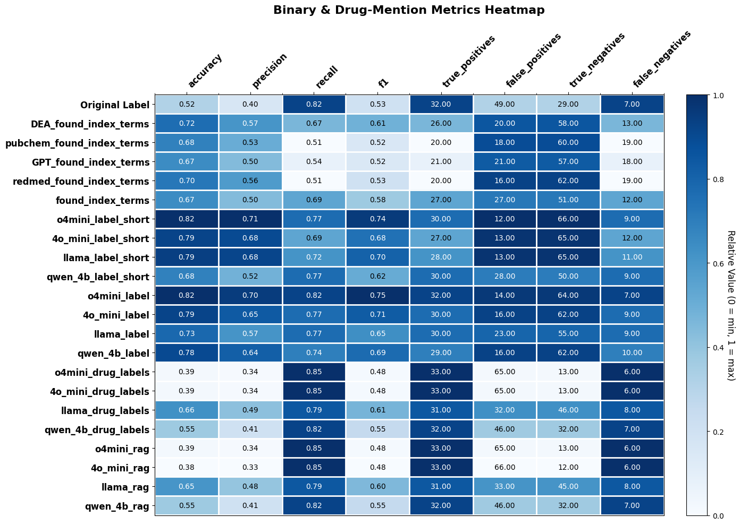
Results
Original dataset label (T/F) →
Synonym Matching
Short Prompt
Long Prompt
Entity Linking
Entity Linking with RAG

Slide 25
Results - Entity Linking
Evaluation Metric Suite (Multi‑Label Drug Detection)
• set‑level and label‑level
– Exact‑Match Accuracy → strict “all‑or‑nothing” set match – Sample‑wise Jaccard Index → partial set overlap score – Micro Precision → correctness of all predicted positives – Micro Recall → coverage of all ground‑truth positives – Micro F1 Score → harmonic mean of micro P & R – Hamming Loss → average per‑label error rate (lower = better)

Slide 26
Results - Entity Linking
Tweet‑Level Metrics
Exact‑Match Accuracy
• strict: one wrong or missing label makes the whole tweet incorrect
Sample‑wise Jaccard Index
• intersection‑over‑union of predicted vs. true sets, averaged over tweets with at least one label. • partial credit for overlap

Slide 27
Results - Entity Linking
Label‑Level Metrics
Micro Precision • fraction of predicted positive labels that are correct • how often is it right
Micro Recall • fraction of ground‑truth labels that were recovered
Micro F1 • harmonic mean of micro precision and recall. • balancing over‑ and under‑prediction
Hamming Loss • average per‑label error rate across all tweet–label pairs. • lower = better

Slide 28
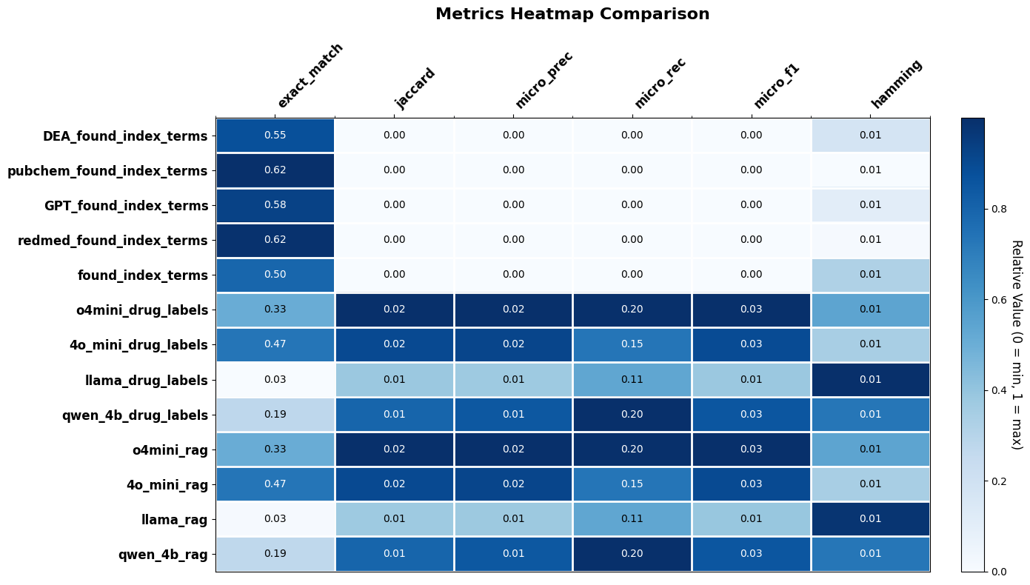

Results - Entity Linking
Synonym Matching
Entity Linking
Entity Linking with RAG

Slide 29
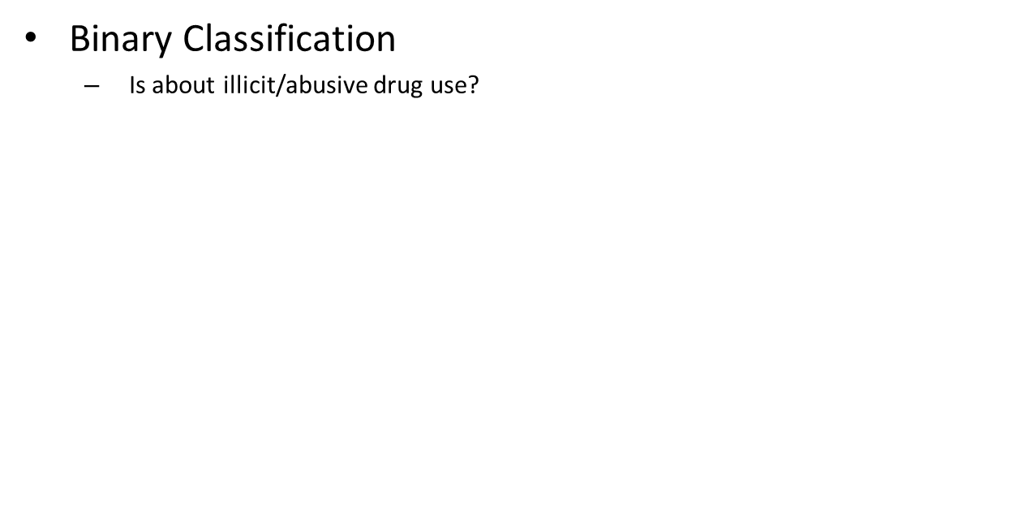
LLM Fine-tuning
Binary Classification
Is about illicit/abusive drug use?
Notes:
I think everybody knows that lithium-ion batteries is a growing technology with a big future. And that batteries have a shelf life.

Slide 30
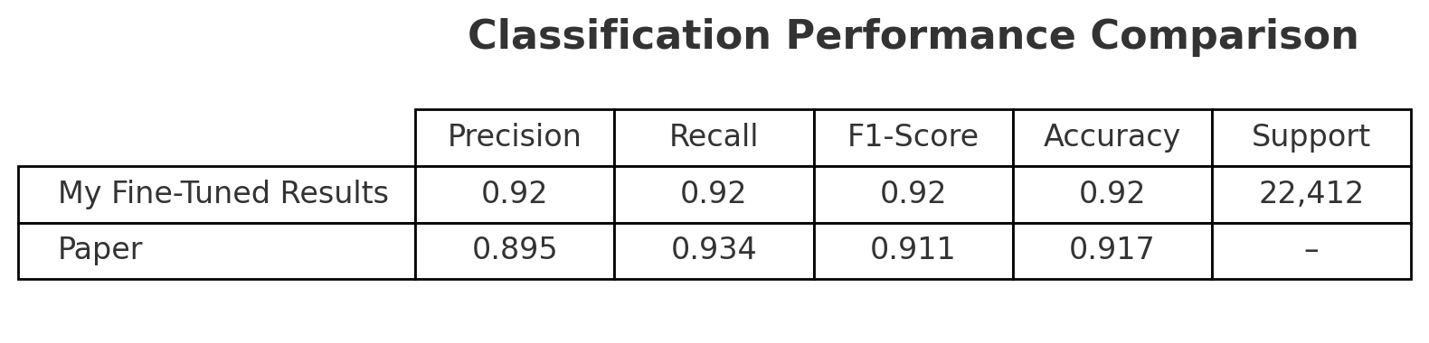




LLM Fine-tuning
Manually annotated Twitter dataset
DeDerta fine-tuning
AutoModelForSequenceClassification
Initial Plan-fine-tune with larger models
Llama/Gwen
LORA & QLoRA

Slide 31
LLM Fine-tuning
Highly subjective labeling
For a tweet to be classified as drug related or non-drug-related in relation to illicit drug use, it should reference certain practices, such as using, selling, smuggling, buying, promoting, or encouraging some kind of drug. A tweet that does not mention any of these aspects should be classified as non-drug-related, regardless of whether it refers to themes of religion, ethnicity, politics, or social issues or if it is on a completely unrelated theme, such as sports or fashion.
In this study, two quality filters were used to ensure the accuracy of the results. In the first filter, the annotator works with the validator. The evaluator then provides the second filter. Great care was taken to minimize potential bias by setting forth explicit directives and affirming our discoveries through a range of methodologies.
Poor sampling
MANY posts related to George Floyd

Slide 32
LLM Fine-tuning
Examples of True Labels
Why Chauvin continued to apply that level of force, even when Floyd was motionless? Why didn't he administer the required drug for the apparent drug overdose? Why didn't he inform the paramedic that the suspect had apparently overdosed . . . ?
One of my great aunts was born in 1915 & would visit from CA every couple yrs. I'd play cards w/ her & my grandma on the floor in front of a TV w/Jeopardy on. They knew most of the answers & would crack jokes or talk abt random stuff from the old days during the Great Depression.

Slide 33
Discussion
Clarify goals of matching drugs
How important is recall?
Purpose driven
Notes:
I think everybody knows that lithium-ion batteries is a growing technology with a big future. And that batteries have a shelf life.

Slide 34
Future Work
Labels Needed
Fine tune llama/Gwen
Disambiguation
Ensemble?
TODO: ADD experience reports
TODO: ADD Labeled tweets etc.
Notes:
I think everybody knows that lithium-ion batteries is a growing technology with a big future. And that batteries have a shelf life.

Slide 35
Future Work
Track terms (and emojis) with drug mentions
Notes:
I think everybody knows that lithium-ion batteries is a growing technology with a big future. And that batteries have a shelf life.

Slide 36
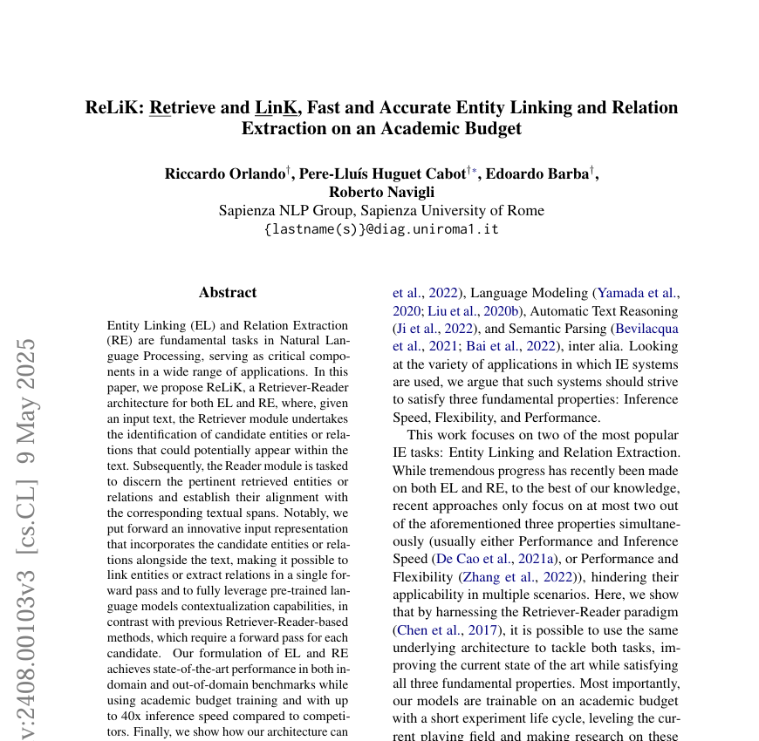
Future Work
Relik Tutorial
Relik GitHub
Notes:
I think everybody knows that lithium-ion batteries is a growing technology with a big future. And that batteries have a shelf life.

Slide 37
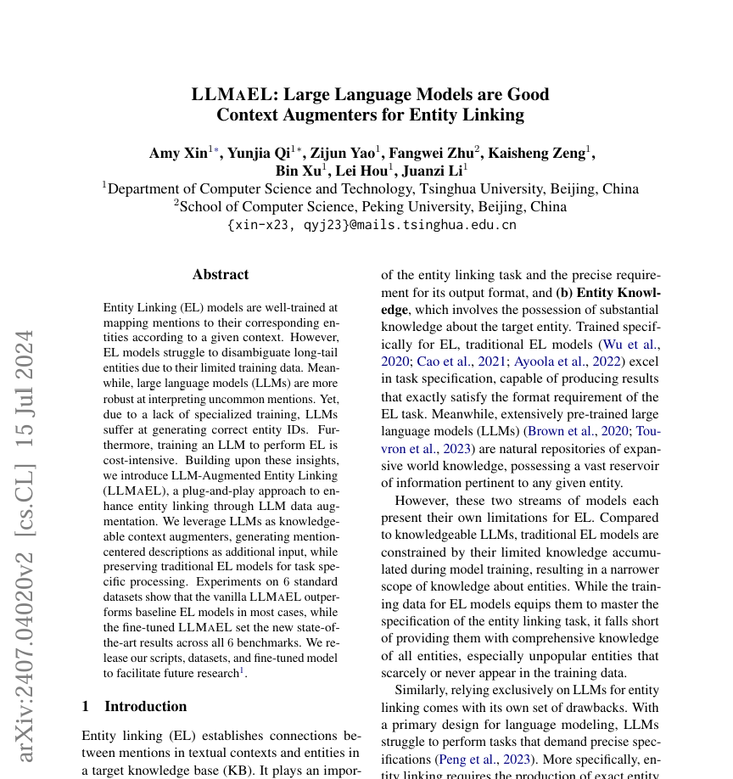
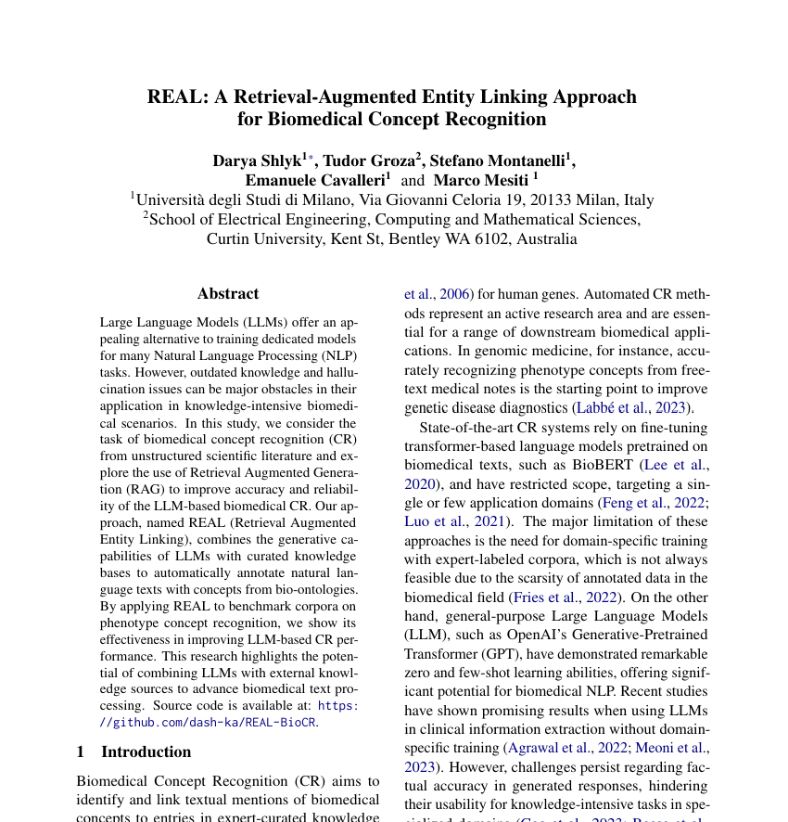
Future Work
Notes:
I think everybody knows that lithium-ion batteries is a growing technology with a big future. And that batteries have a shelf life.

